Slide 1

Georgios Zervas
The 1-Dollar-Revolution
Why a Global Minimum Wage

Slide 2
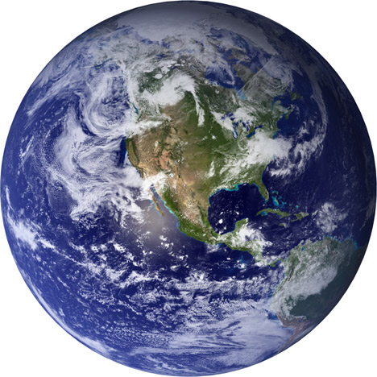
Worldpolitics – interim balance
Poverty : Although the average income per world citizen has ten folded in the last 100 years from 1000 to 10.000US dollars, 1.2 billion people still live on less than 1.25 dollars a day and 2.5 billion on less than $ 2.
Environmental disasters: Even after 50 years of active environmental movement and environmental policy, the gap between the need for action and successful action on key issues, such as climate change and species conservation, continues to grow.
Wealth gap: a textile worker in Bangladesh
earned in a month as much as a skilled
worker in Germany in an hour.
Ratio: 1: 160.The 62 richest people
in the world today have as much wealth
as half of mankind. Ratio: 1: 60,000,000.
62
richest*)
*) 10 years ago
they where
yet 400
have as much as
the bottom half
of humanity

Slide 3
The global crisis situation...
Immigration...
  2010: 45 million refugees worldwide
  2016: 65 million refugees worldwide
Population Explosion in Africa...
  2016: 1,2 billion people
  2100: 4,1 billion people
Nationalist parties...
  2010: 5-15 % share of the vote
  2016: 15-50 % share of the vote
Violence & Terror...
  Rapid increase despite the multibillion spending on security
...and much more...

Slide 4
“It's always the simplest ideas,
which have the outstanding success.”
Leo Tolstoi
How do we set
the ball rolling?
For a better future for all.

Slide 5
1-Dollar-Revolution
as a global
minimum wage level.
1 Dollar per Hour as a global
min. wage
That‘s the subject of this book.

Slide 6
Two solutions...
Minimum prosperity for all! For most major challenges - Population explosion, immigration, poverty, fear of loss, violence, radical voting decisions and many more –that was found to be the most effective and sustainable solution: the creation of better life prospects!
Systemic solutions! Throughout the entire evolutionary history the greatest advances have been achieved when systemic solutions have been found. The wide expansion of the digital world opened up only when the numeric system from 0 to 9 was reduced to 0 and 1, and was therefore linked to the electronics.
A global minimum wage is a systemic solution with sustainable effect. It radically improves the life prospects of previously excluded parts of mankind, thereby providing all mankind with immense new development potentials.

Slide 7
A global minimum wage
of 1 Dollar per hour as a global Minimum wage level would...
…instantly and directly raise the income of one billion people on the border of absolute poverty.
...give these people the opportunity to take their lives and the lives of their families in their own hands much more proactively (access to education, good nutrition, clean energy, modern technology i.e.)
…address numerous causes of immigration and causes of other global problems, by which we all are affected.
...induce a global economic miracle in place where it is most urgent and effective.
…increase the amazingly low wages (slave wages) because of the costs in our stores for products from the present regions.
...benefit today‘s "poverty-markets" helping them integrate totally into the strong global economy.

Slide 8
What if a global minimum wage
was to be introduced?
The ideal way: Regarding the WTO, ILO and UN. It would be ideal to make an appointment with the UN General Assembly in terms of the "Global Goals" adopted by the appropriate international organizations such as WTO, ILO etc. Since this path would be difficult and lengthy, we suggest the following initial steps:
The realistic way: Regarding the EU. The European Union has already created numerous environmental and health standards, and made compliance with them compulsory for imports in the EU.
The proposal: set the first binding social standards for imports in the EU as well as the global Minimum wage level of $ 1 per hour (it should be implemented economically and politically worldwide).

Slide 9
Text for an EU regulation about
the global minimum wage:
"All products that are traded on the EU market must comply with the EU's fundamental values. To be manageable and understandable, the products need an EU approval number. The manufactures must have their products certified according to eco-social standards, before they receive this approval. For social standards SA8000 must be available, while for environmental standards ISO 14001is essential. Regarding social standards, a global minimum wage of $ 1 per hour must also be met in the beginning of 2017.”
Such EU regulation is competition-neutral and the EU can therefore impose WTO-compliant. The effect would be global:
No global Companies can afford not to serve the EU market.

Slide 10
New Deal 21: prosperity and
safeguarding the future in the 21st century
Minimum prosperity insurance - by the global minimum wage. The proposed introduction of a global Minimum wage level will be permanently recorded in history books.
Securing the future - by Global Goals Fund. A second proposal concerns the establishment of a Global Goals Fund:
Financing: Similarly to the way member states finance the EU, each country should pay 1 percent of its gross domestic product to a global fund. This represents a total of about 800 billion dollars.
Use of resources: As a consequence the Fund of Global Unemployment and Social Security should finance, with the amount of $1,25 per day (poverty limit), those who continue to have no such protection – their funding should also be unanimously approved of by the UN.

Slide 11
Future for all!
When not only a small part of humanity, but all mankind can develop its human potential-who will lose?
The Power of Social Inclusion.
A future for all is much richer and more sustainable and peaceful and above all much more human.

Slide 12
„By aiming the welfare of others,
we encourage our own.“
Plato
„ We are facing breathtaking opportunities
disguised as unsolvable problems.“
John W. Gardner

